Slide 1
Break the monolith!
An intro to distributing your workload in the cloud
Jeff Putz - @jeffputz

Slide 2


Slide 3
Just kidding.
Welcome to Orlando Code Camp!

Slide 4
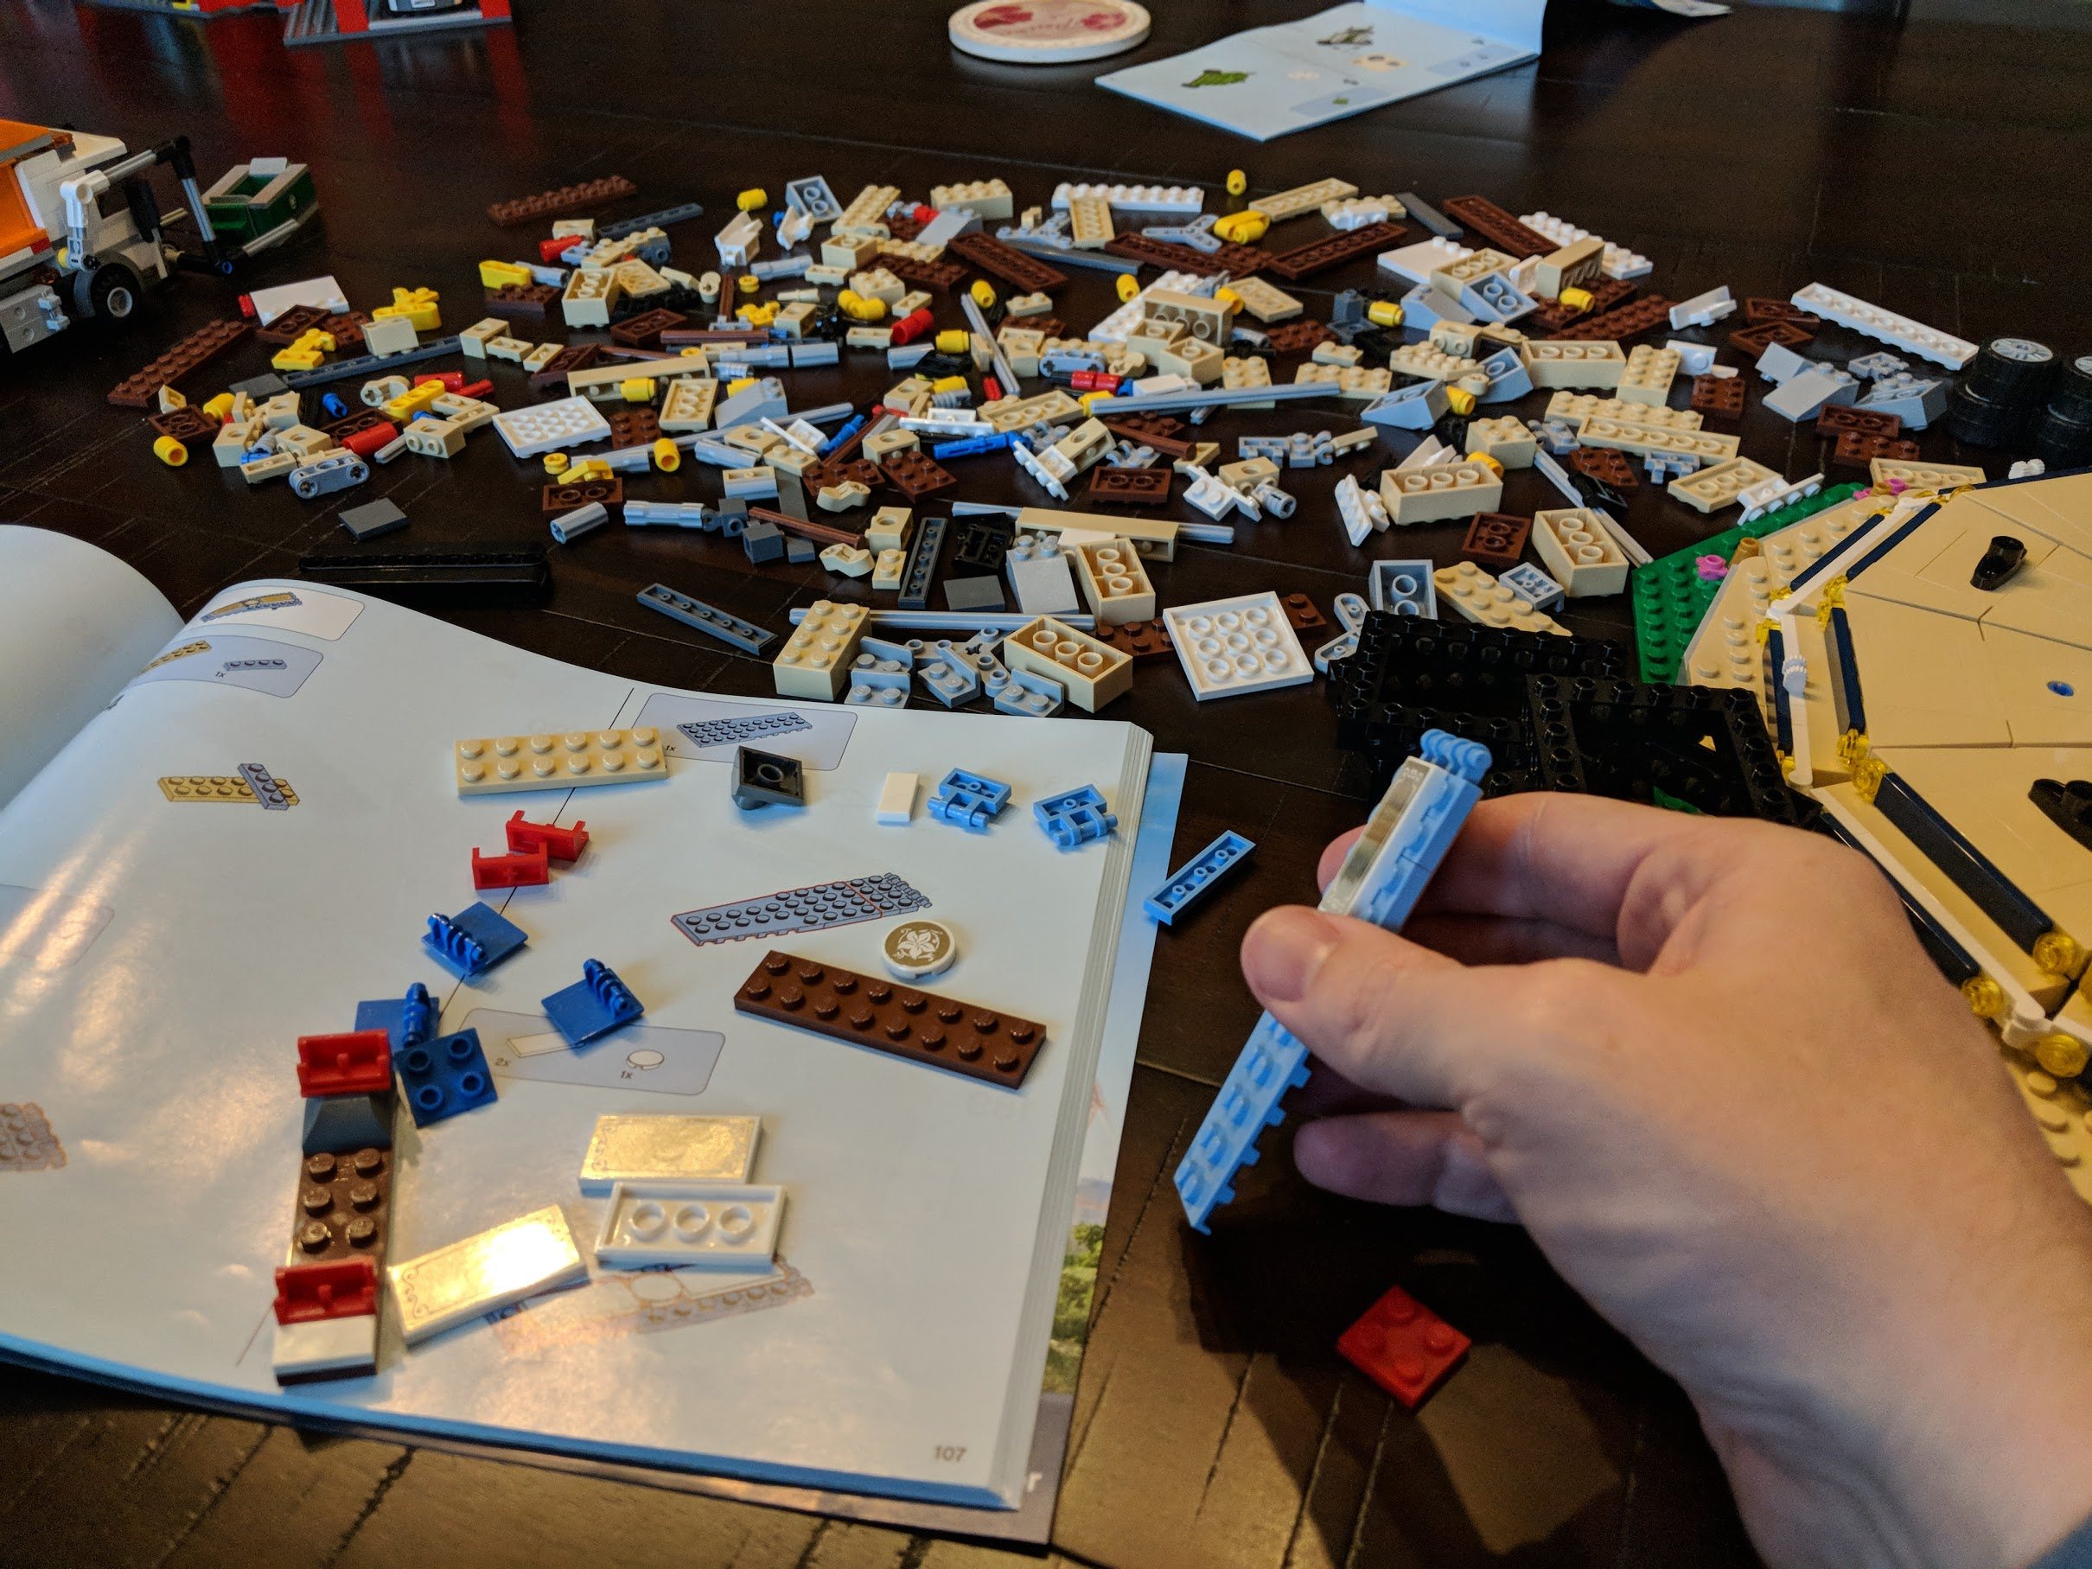

Slide 5
About me
Working the softwares since 1999-ish.
Diverse experience, from megacorps like Microsoft and Humana to startups and dot-com flameouts.
Currently VP of Product Development and Software Engineering for novi AMS (association management SaaS product).
Been hiring people on and off for the last ten years.
Current career stage: Visio, email and occasionally code.
Decks: https://github.com/jeffputz
jeff@popw.com and on the Twitter @jeffputz

Slide 6
Who this is for
Software developers, every level
Managers who want to understand distributed cloud computing

Slide 7
What is a monolith?
An application that exists largely as one code base executing in one place and persisting data nearby.
It must be wholly replaced at any given time when changed.
Also: Rectangular machines in the Space Odyssey books having a 1:4:9 ratio.

Slide 8
What is a distributed workload?
Many pieces of independent software working toward a common goal.
Communicate via messages.
Components can be changed independently.
Can execute tasks in parallel when necessary.
Might have shared state.

